Slide 1
Weekly report 10/21/2019-10/27/2019 Tengteng Tao
Work Done
Figure out the relationship between the measuring direction of hall voltage and the direction of sample current
Use Origin fit the I-V data provided by Poomirat
Work to be done
Contact Dr. Sarah An to get more details about the sample I have tested before
Improve the fitting accuracy and fit other I-V curve
`

Slide 2
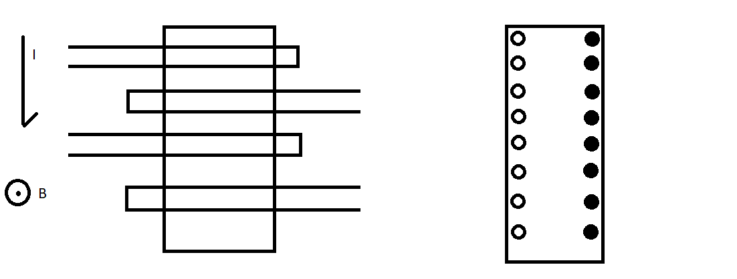
Weekly report 10/21/2019-10/27/2019 Tengteng Tao
Hall Voltage:
Due to the current we introduced to the sample and the magnetic field we applied, the holes and electrons will accumulate on the two sides of the sample. Ideally, each side of this sample should have equal potential. In this condition, no matter which specific position we measure, the sample should give us the same value of the Hall voltage.

Slide 3
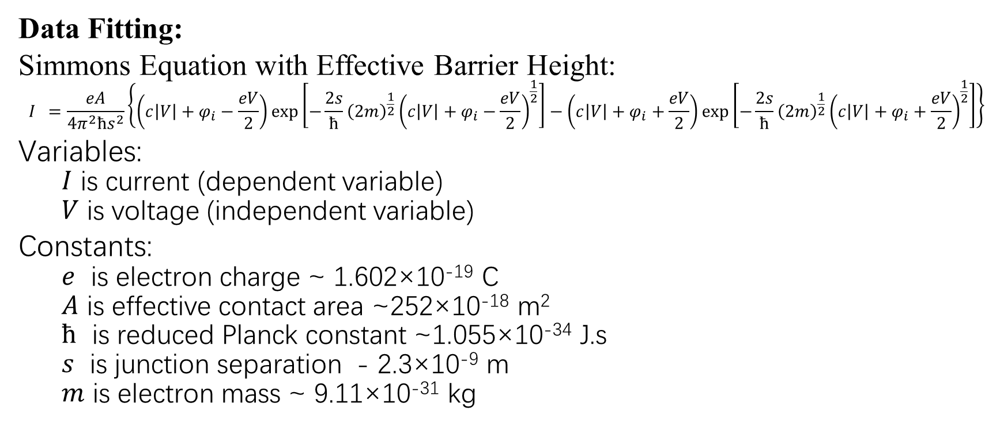
Weekly report 10/21/2019-10/27/2019 Tengteng Tao
Data Fitting:
Simmons Equation with Effective Barrier Height:
$$I =\frac{eA}{4π^{2}ħs^{2}}\left\{\left(c\left|V\right|+φ_{i}−\frac{eV}{2}\right)\exp\left[−\frac{2s}{ħ}{\left(2m\right)}^{\frac{1}{2}}{\left(c\left|V\right|+φ_{i}−\frac{eV}{2}\right)}^{\frac{1}{2}}\right]−\left(c\left|V\right|+φ_{i}+\frac{eV}{2}\right)\exp\left[−\frac{2s}{ħ}{\left(2m\right)}^{\frac{1}{2}}{\left(c\left|V\right|+φ_{i}+\frac{eV}{2}\right)}^{\frac{1}{2}}\right]\right\}$$
Variables:
$I$ is current (dependent variable)
$V$ is voltage (independent variable)
Constants:
$e$ is electron charge ~ 1.602×10⁻¹⁹ C
$A$ is effective contact area ~252×10⁻¹⁸ m²
$ħ$ is reduced Planck constant ~1.055×10⁻³⁴ J.s
$s$ is junction separation - 2.3×10⁻⁹ m
$m$ is electron mass ~ 9.11×10⁻³¹ kg

Slide 4
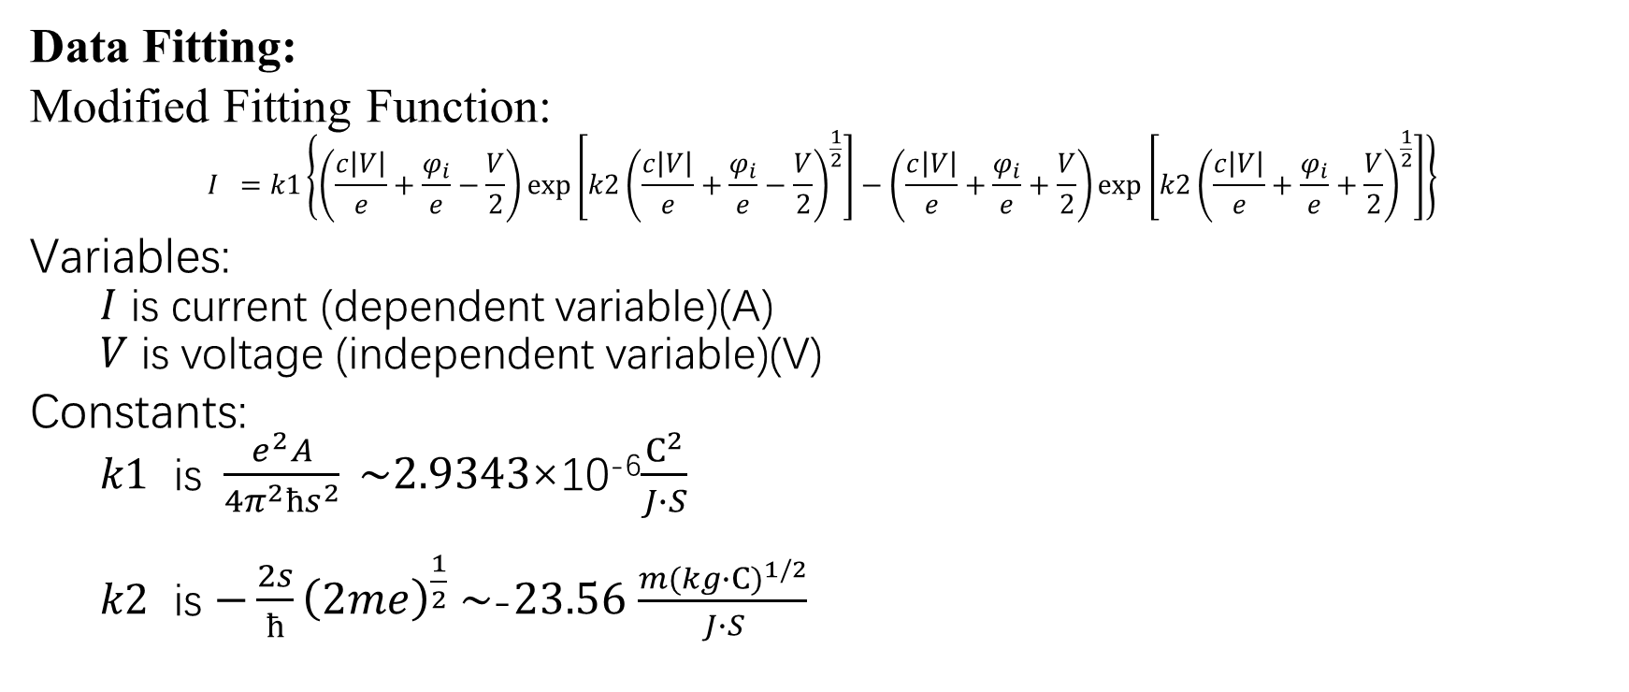
Weekly report 10/21/2019-10/27/2019 Tengteng Tao
Data Fitting:
Modified Fitting Function:
$$I =k1\left\{\left(\frac{c\left|V\right|}{e}+\frac{φ_{i}}{e}−\frac{V}{2}\right)\exp\left[k2{\left(\frac{c\left|V\right|}{e}+\frac{φ_{i}}{e}−\frac{V}{2}\right)}^{\frac{1}{2}}\right]−\left(\frac{c\left|V\right|}{e}+\frac{φ_{i}}{e}+\frac{V}{2}\right)\exp\left[k2{\left(\frac{c\left|V\right|}{e}+\frac{φ_{i}}{e}+\frac{V}{2}\right)}^{\frac{1}{2}}\right]\right\}$$
Variables:
$I$ is current (dependent variable)(A)
$V$ is voltage (independent variable)(V)
Constants:
$k1$ is $\frac{e^{2}A}{4π^{2}ħs^{2}} \sim 2.9343$×10⁻⁶$\frac{C^{2}}{J∙S}$
$k2$ is $−\frac{2s}{ħ}{\left(2me\right)}^{\frac{1}{2}} \sim$-$23.56$ $\frac{{m(kg∙C)}^{1/2}}{J∙S}$

Slide 5
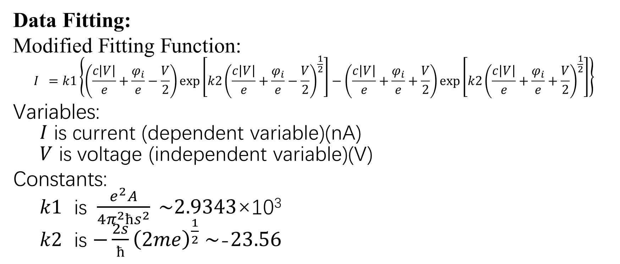
Weekly report 10/21/2019-10/27/2019 Tengteng Tao
Data Fitting:
Modified Fitting Function:
$$I =k1\left\{\left(\frac{c\left|V\right|}{e}+\frac{φ_{i}}{e}−\frac{V}{2}\right)\exp\left[k2{\left(\frac{c\left|V\right|}{e}+\frac{φ_{i}}{e}−\frac{V}{2}\right)}^{\frac{1}{2}}\right]−\left(\frac{c\left|V\right|}{e}+\frac{φ_{i}}{e}+\frac{V}{2}\right)\exp\left[k2{\left(\frac{c\left|V\right|}{e}+\frac{φ_{i}}{e}+\frac{V}{2}\right)}^{\frac{1}{2}}\right]\right\}$$
Variables:
$I$ is current (dependent variable)(nA)
$V$ is voltage (independent variable)(V)
Constants:
$k1$ is $\frac{e^{2}A}{4π^{2}ħs^{2}} \sim 2.9343$×10³
$k2$ is $−\frac{2s}{ħ}{\left(2me\right)}^{\frac{1}{2}} \sim$-$23.56$

Slide 6
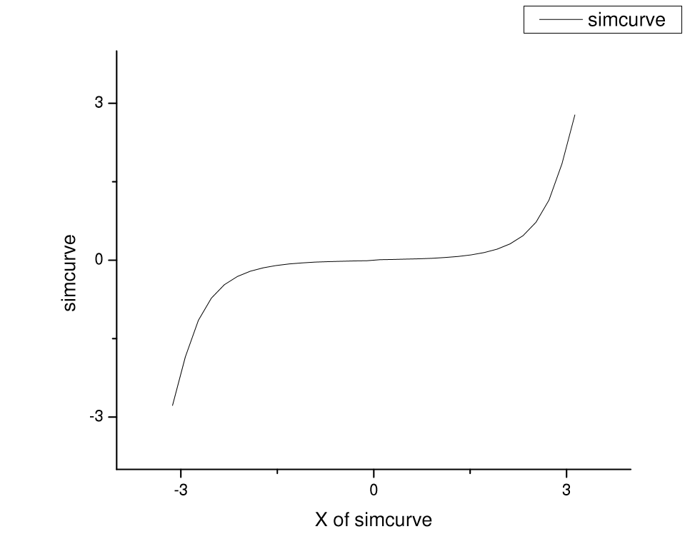

Weekly report 10/21/2019-10/27/2019 Tengteng Tao
Fitting Result:
Simulate Curve:
In order to test my function, I plug in the expected fitting values and plot the simulate curve.
Parameters:
$k1$ = $2.9343$×10³
$k2$ = $23.56$
$φ_{i}$ =0.223 eV
$c$ = 0.432 eV/V

Slide 7
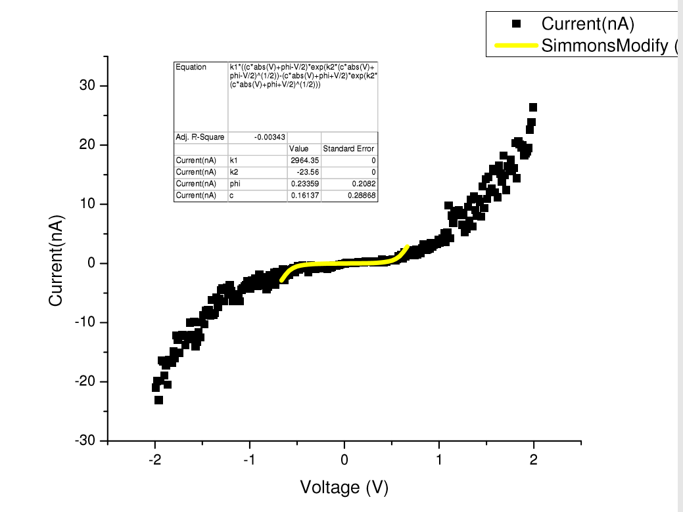
Weekly report 10/21/2019-10/27/2019 Tengteng Tao
Fitting Result:
Original data and fitting curve:
We can see that the function only fit a small part of the whole data set.
After comparing the simulate curve and original data. I found that the function I write can only have a range from -3 nA to 3nA. However, the data set has a range from -30 nA to 30 nA. After my consideration, I think t there must be some mistakes in the original data set of in the process I used to simply the fitting function.

Slide 8
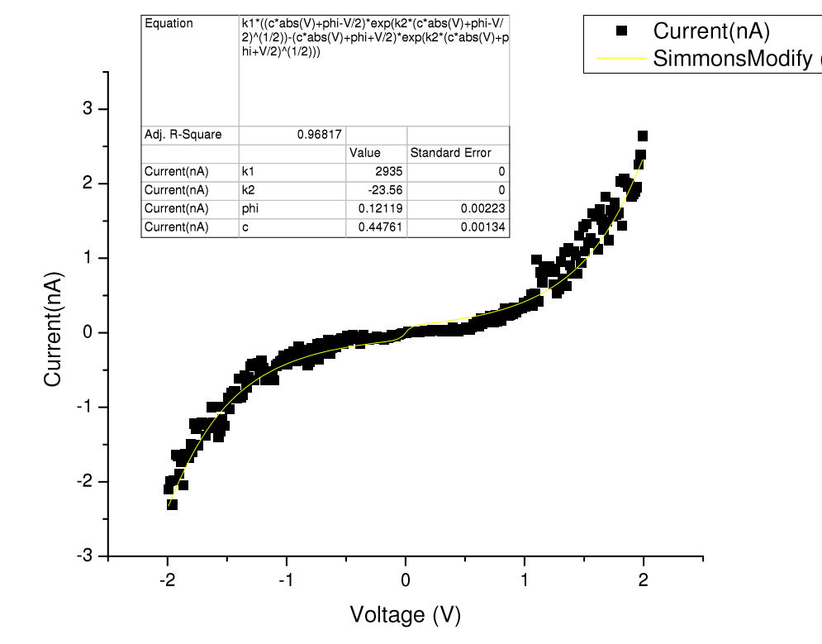

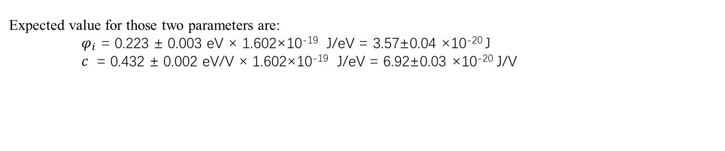
Weekly report 10/21/2019-10/27/2019 Tengteng Tao
Fitting Result:
Original data and fitting curve:
I tried to multiply the data by ${10}^{10}$ instead of ${10}^{9}$ and fitted the original data. This time, I get a better fitting result. In this fitting result, the fitted parameters are:
$φ_{i}$ =0.121 eV ± 0.002 eV × 1.602×10⁻¹⁹ J/eV = 1.938±0.003 ×10⁻²⁰ J
$c$ = 0.447 eV/V ± 0.001 eV/V × 1.602×10⁻¹⁹ J/eV
= 7.161±0.001 ×10⁻²⁰ J
Expected value for those two parameters are:
$φ_{i}$ = 0.223 ± 0.003 eV × 1.602×10⁻¹⁹ J/eV = 3.57±0.04 ×10⁻²⁰ J
$c$ = 0.432 ± 0.002 eV/V × 1.602×10⁻¹⁹ J/eV = 6.92±0.03 ×10⁻²⁰ J/V

